Slide 1


A SEMINAR ON
AGRICULTURE AUTOMATION WITH AUTOMATED SHELTER SYSTEM FOR CROP PROTECTION & PULSE GENERATING ELECTRIC FENCING
(VIII – Semester)
Presented By:
7861. MOHIT RAJENDRA KHOBRAGADE
7830. SALONI DIWAKAR CHAMBHARE
7862. DAMINI GAJANAN LIDABE
7860. SAKSHI BHIMRAO DUPARE
Under the guidance of:
Prof. S.Y. KAMDI
SARDAR PATEL MEMORIAL SOCIETY’S RAJIV GANDHI COLLEGE OF ENGINEERING, RESEARCH & TECHNOLOGY CHANDRAPUR (NAAC ACCREDIATED)
DEPARTMENT OF ELECTRICAL ENGINEERING

Slide 2
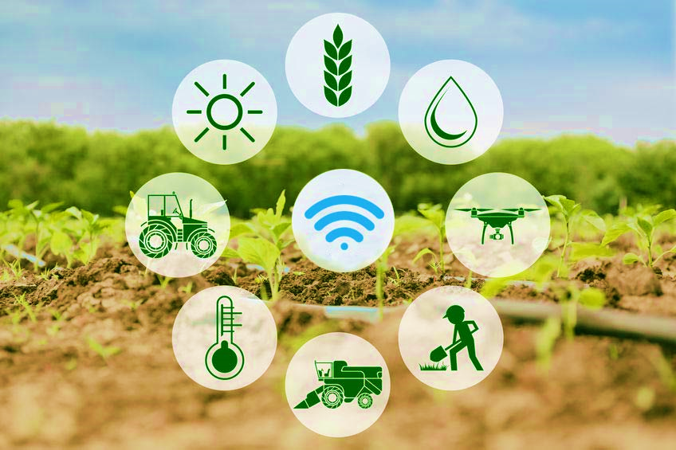
AGRICULTURE AUTOMATION WITH AUTOMATED SHELTER SYSTEM FOR CROP PROTECTION & PULSE GENERATING ELECTRIC FENCING

Slide 3
ABSTRACT
Internet of Things (IOT) technology has brought revolution to each and every field of common man’s life by making everything smart and intelligent. IoT refers to a network of things which make a self configuring network.
The development of Intelligent Smart Farming IoT based devices is day by day turning the face of agriculture production by not only enhancing it but also making it cost-effective and reducing wastage.
The aim / objective of this report is to propose IoT based Smart Farming System assisting farmers in getting Live Data (Temperature, Soil Moisture) for efficient environment monitoring which will enable them to increase their overall yield and quality of products.

Slide 4
INTRODUCTION
Internet of things IOT consists of two words Internet and Things .The term things in IOT refers to various IOT devices having unique identities and have capabilities to perform remote sensing , actuating and live monitoring of certain sort of data.
IOT devices are also enable to have live exchange of data with other connected devices and application either directly or indirectly , or collected data from other devices and process the data and send the data to various servers.

Slide 5
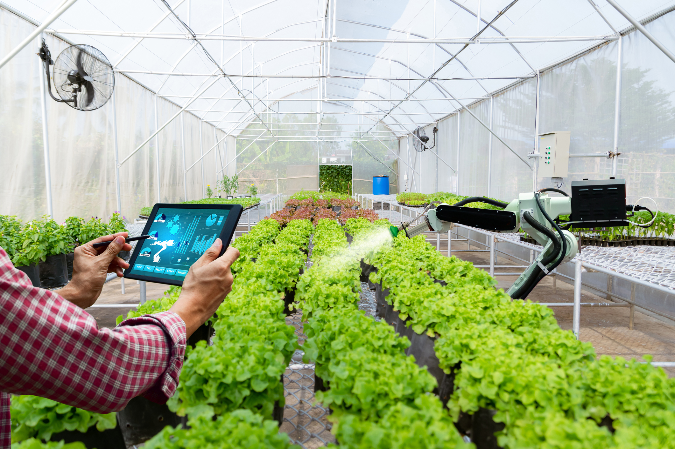
The other term internet is define as Global communication Network connecting Trillions of computers across the planets enabling sharing of information .Thus the IOT can be define as :”A dynamic Global Network Incrusted with self configuring capabilities based on standard and inter operable communication to protocol where physical and virtual things have identities, physical attributes ,and virtual personalities and use intelligent interfaces and are seamlessly integrated into the information network ,often communicate data associated with user and their environment.”

Slide 6
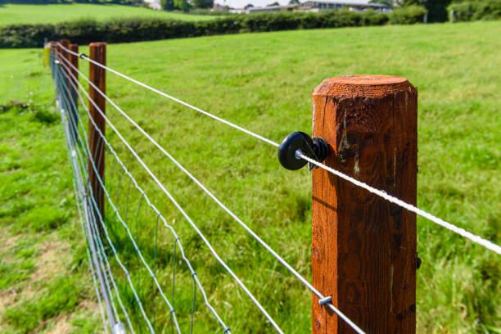
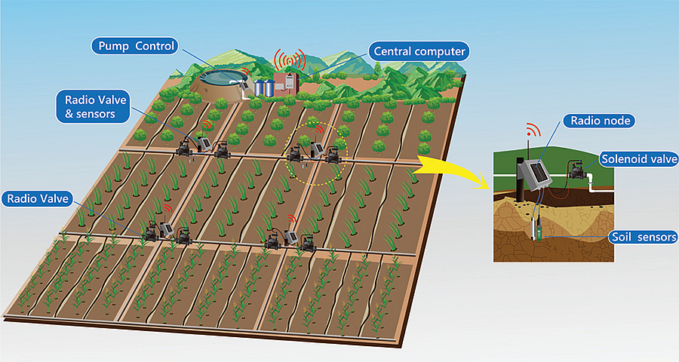
PULSE GENERATING ELECTRIC FENCING
SOIL & MOISTURE SENSORS WITH AUTOMATIC PUMPING SYSTEM

Slide 7
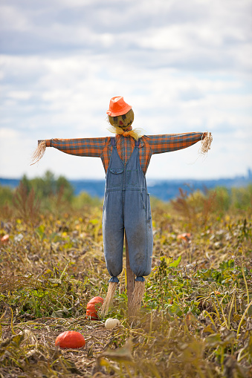
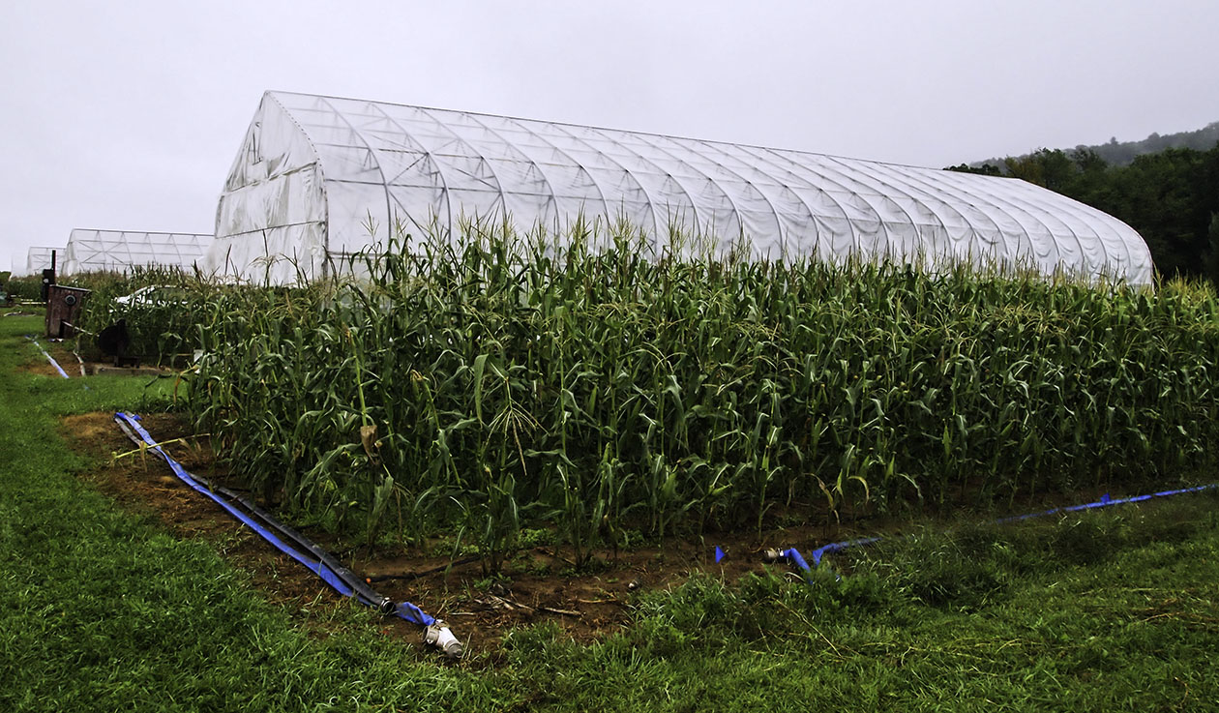
AUTOMATIC SCARECROW WITH PIR SENSOR AND SERVOMOTOR
AUTOMATED SHELTER SYSTEM WITH RAIN SENSOR

Slide 8
Literature survey
•Smart Agriculture or Smart farming Data, tons of data, collected by smart agriculture sensors of soil quality, crop’s grow etc. For, better control over the internal processes and, as a result, lower production risks. Thus enhances product quality and volumes which leads to high revenue.
•Crop management The premier function is to monitor the crop growth utilizing digital means. This will give the accurate values of different parameters upon which the growth depends. Other than this, it will help the farmer to monitor more than one agricultural land at the same time.

Slide 9
•Green house automation Greenhouse Automation Systems work around the clock to enhance the climate in greenhouse, increase crop yields, and reduce energy costs as well as labor costs. The system protects the entire green house against the weather conditions and immediately notify you with and alarm should something go awry, giving you the freedom to not have to monitor the greenhouse at all times yourself.
•End-to-end farm management systems A sequence of activities that can be automatically or physically allotted to a user or set of users that will help to complete a task

Slide 10
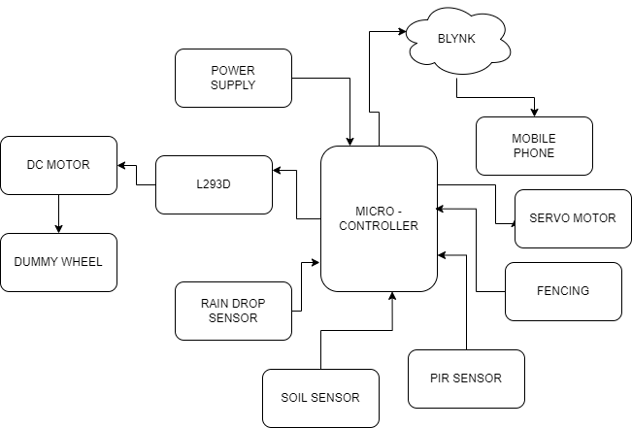
BLOCK DIAGRAM

Slide 11
WORKING
Our project will be handled by NodeMCU microcontroller. Soil sensor will monitor moisture present in soil so that controller can switch on and off water pump automatically. Rain detection sensor will detect rain so that roof of garage can open and close accordingly. Electric fencing is used to keep animal away from farm. PIR Sensor will detect birds and switch on scarecrow.

Slide 12
Component List
NodeMCU
Soil Moisture Sensor
Rain Sensor
Fencing
Blynk Application
Copper plate
Resistor
Led
PIR Sensor
Servo motor

Slide 13
ADVANTAGES OF IT IN THE AGRICULTURAL SECTOR
Data collection. All data can be collected with the help of installed sensors. ...
Reduction of risks. ...
Business goes automated. ...
Higher quality. ...
Livestock monitoring. ...
Monitoring climate conditions. ...
Greenhouses automation. ...
Crop monitoring.

Slide 14
Disadvantages
IOT – smart farming continually requires internet connectivity. ...
The IOT related equipment allows the farmer to understand the use of technology and to learn. ...
Given any security measures, the system offers little power and can lead to various kinds of network attacks.

Slide 15
REFERENCE
1. Tamoghna Ojhaa, Sudip Misra, Narendra Singh Raghuwanshi Wireless sensor networks for agriculture: The state-of-the-art in practice and future challenges, Computers and Electronics in Agriculture 118 66– 84,ELSEVIER,2015
2. IbrahimMat,MohamedRawideanMohdKassim,AhmadNizarHarun,IsmailMatYusoffIoTin Precision Agriculture Applications Using Wireless Moisture Sensor Network, MIMOS, Ministry of Science, Technology and Innovation, KualaLumpur, MALAYSIA (2016) IEEE Conference on Open Systems(ICOS), October 10-12, 2016, Langkawi,Malaysia).
3. Ojas Savale,Anup Managave,Deepika Ambekar, Sushmita Sathe Internet of Things in Precision Agriculture using Wireless Sensor Networks., Internet of Things in Precision Agriculture using Wireless Sensor Networks
4. Ahmad Nizar Harun,Mohamed Rawidean Mohd Kassim,IbrahimMat,SitiSarah Ramli Precision Irrigation using Wireless Sensor Network, MIMOS (2015 International Conference on Smart Sensors and Application(ICSSA))

Slide 16
THANK YOU!!!

